Slide 1
Car Lights
Garage Program

Slide 2
What is Electrical & Computer Engineering (ECE)
Design & analyzation of electrical circuits and systems
Basic analog & digital circuits
Chips inside phones and computers
Wired & wireless communication
Electronics within a car

Slide 3
# Stages of Electrical Circuit Design
Design circuit in software
Build and test circuit on breadboard
Build and test circuit on proto-board
Build and test circuit on printed circuit board (PCB)

Slide 4
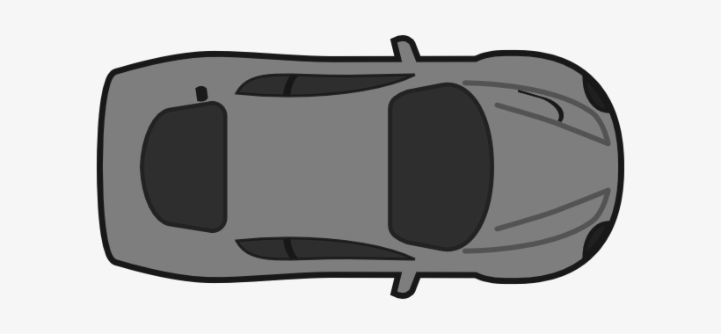
The Project
Recreating a cars lights
Headlights
Turn Signals
Running Lights
Brake Lights

Slide 5
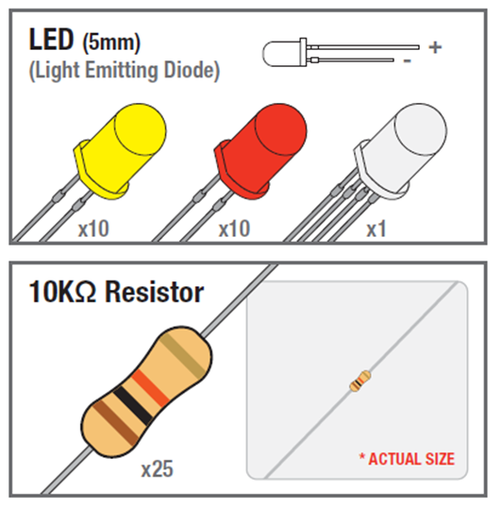
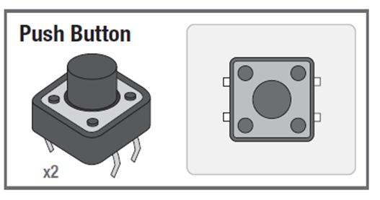
The Parts
Arduino Nano
LEDs
Buttons
Resistors
Prototyping Board
Wire

Slide 6
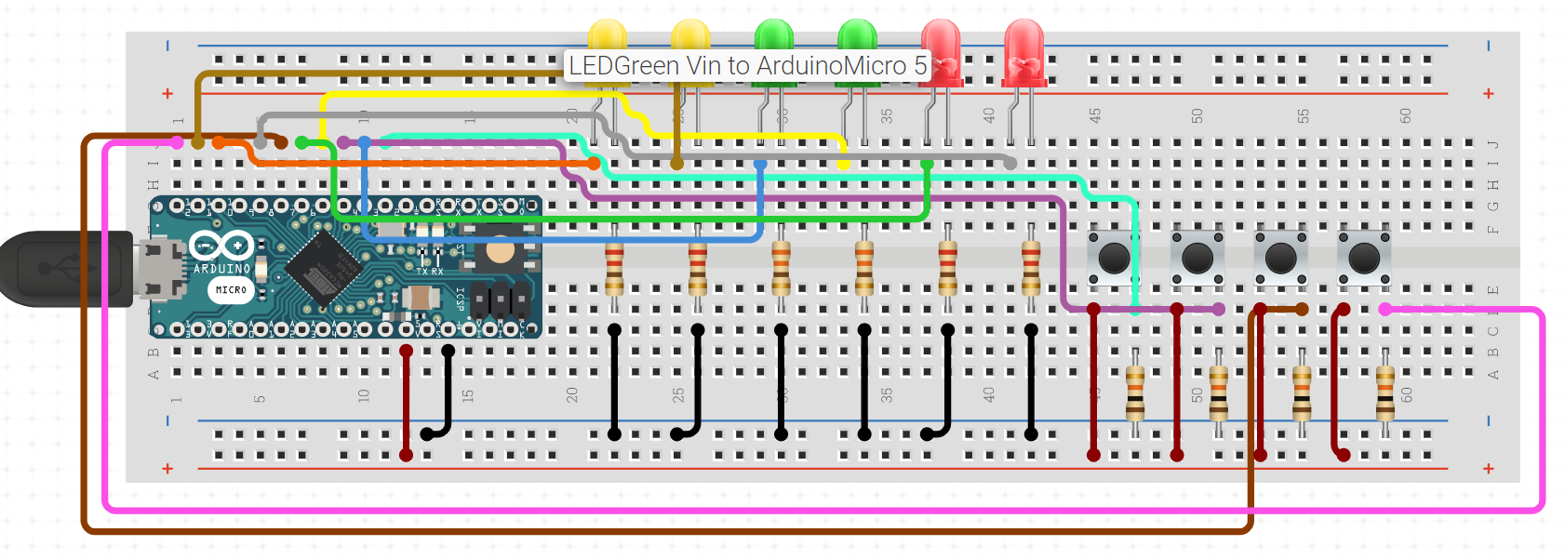
The Circuit

Slide 7
How to Assemble the Proto-Board
Place the Arduino into the proto board
The USB board should be facing the left side
Place the green LED “headlights”
Place the red LED “brake lights”
Place the orange LED “turn signals”
(All LEDs should have the long leads to the left)

Slide 8
How to Program the Boards
If the Brake is pressed
Tun on the light
Otherwise
Turn off the brake light
If the Light is pressed
Check the status of the lights (on or off)
Turn lights on or off based on previous state
If the turn signal is pressed
Check the status of the turn signal(on or off)
Flash lights based on previous state

